Slide 1

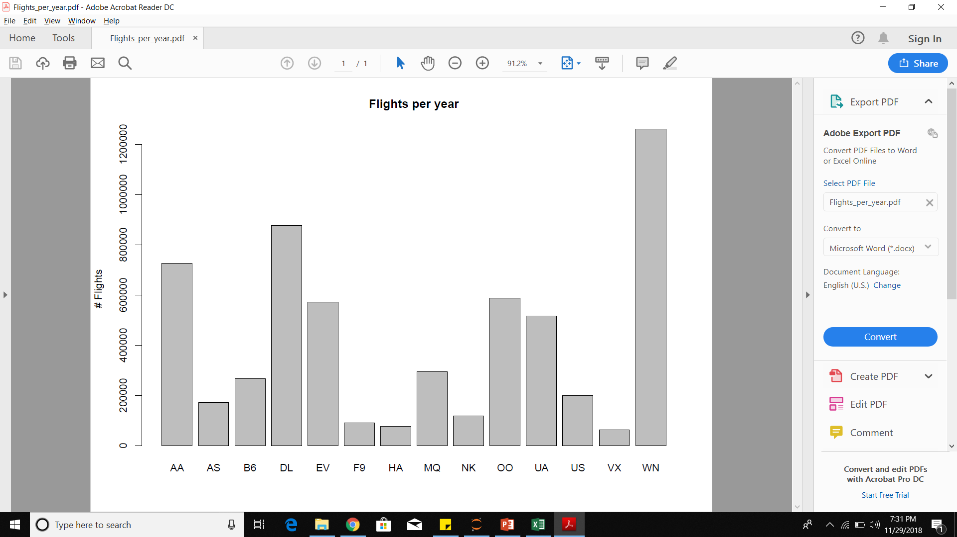
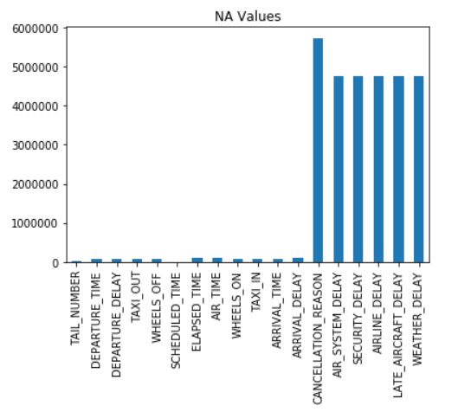
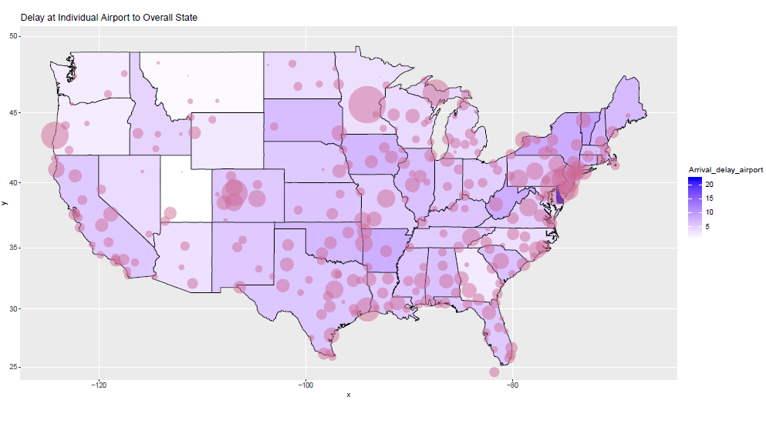
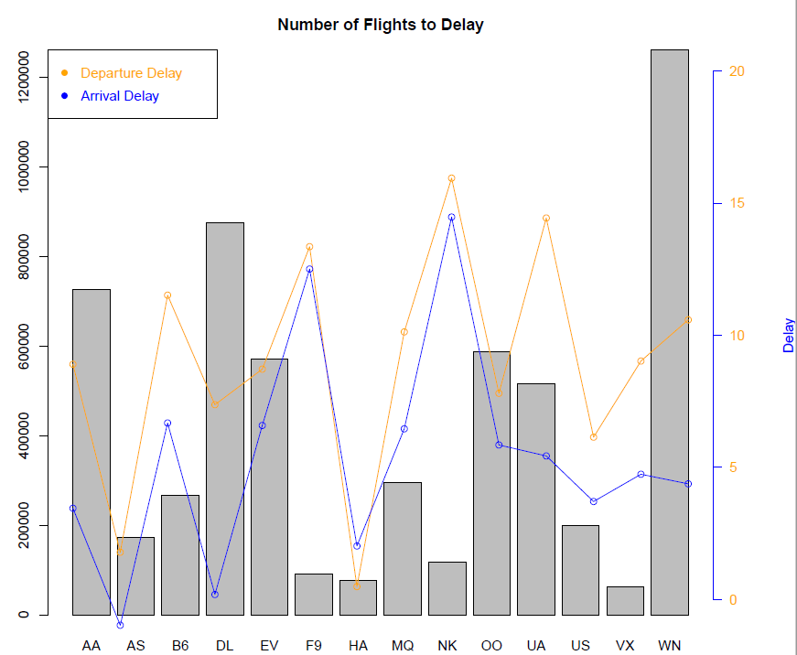
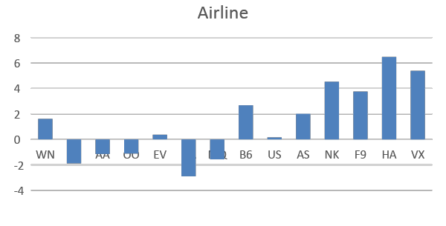
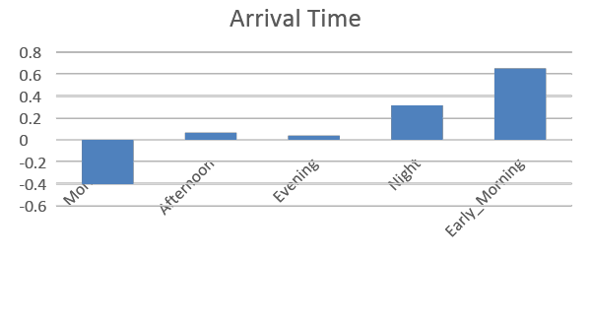
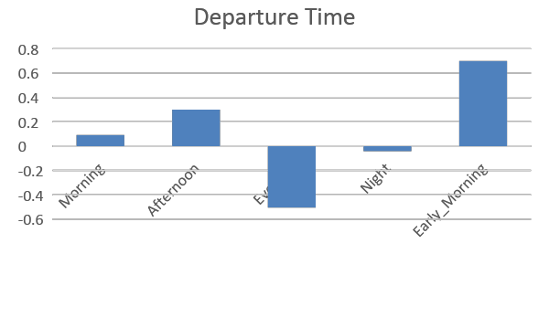
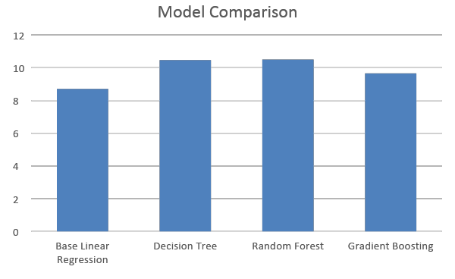
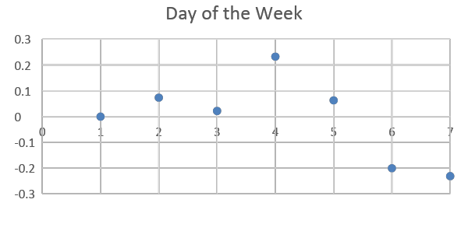
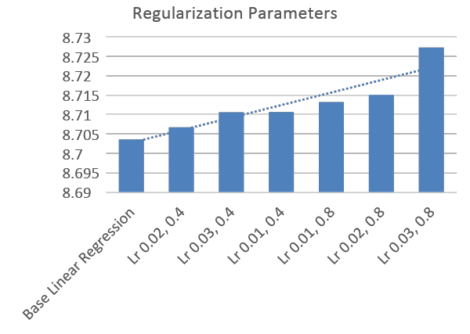
IST 718:Big Data Analytics
Palaniappan M
Pranay Lulla
Raghav Raheja
Vaibhav Nigam
Predicting Airtime Delays
Problem Statement
Data Exploration
In 2015, around 21.72 % flights were delayed due to different reasons [1]
Thus, we decided to predict what are the factors that effect the airtime delay, and identify important features causing delay
Data Description
Our Dataset consist of 18 features and 5.7M records. It consist of data of year 2015 flight delays across United States. It contains a calculated columns Airtime_delay which is used as a predictor variable.
Feature Coefficients
Model Description
Model | Features | Techniques | Evaluation
Linear Regression | Month | String Indexer | 12.8897
Linear Regression | Month | String Indexer, One Hot Encoder | 12.8715
Linear Regression | Day | String Indexer | 12.8901
Linear Regression | Day | String Indexer, One Hot Encoder | 12.8841
Base Linear Regression | Taxi out, Distance, Taxi in, Departure delay, Month, Day, Day of week, Airline, Departure time, Arrival time, Origin airport, Destination airport | String Indexer, Vector Assembler, One Hot Encoder, Pipeline | 8.7096
Random Forest |  |  | 10.5067
Decision Tree |  |  | 10.4701
Gradient Boosting |  |  | 9.6540
Data Cleaning: Handling NAs and derived columns
Feature Engineering: Converting time into categories and derive columns
Handling Categorical Variables: Testing the best model for conversion
Models: Performed models to predict airtime delay of the flights
Methods
Objectives
Conclusion
Exploratory data analysis to analyze the dataset for summarizing the main characteristics
Calculating the Airtime Delay by the difference of Elapsed time and Scheduled time
Applying Regression Modeling techniques
We found that the best model in our case out of all the models that we ran was linear regression without the regularization parameters
We have used twelve features to predict the airtime delay with the best root mean square error of 8.7100 on the testing data.
References
[1] https://www.transtats.bts.gov/HomeDrillChart.asp
[2] https://www.kaggle.com/usdot/flight-delays

